Slide 1
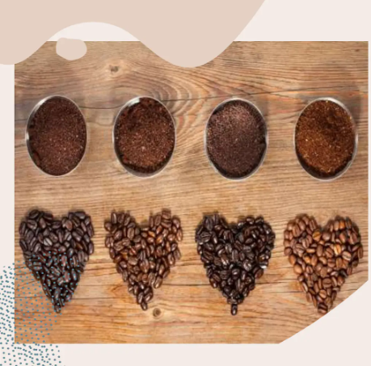
Capstone Project: Exploring Coffee Quality Data
By Mona Kumari Student ID : S9979

Slide 2
Objectives
The primary goals of this project are:
To identify the key determinants of coffee quality as evaluated through sensory attributes such as aroma, flavor, and acidity.
To explore the correlation between processing methods, origin regions, and coffee quality scores.
To identify trends or patterns in defect occurrences and their impact on overall coffee quality.
To analyze how different variables interact to influence the Total Cup Points, an overall measure of coffee quality.

Slide 3
Data Overview of Coffee Quality Data from CQI
The Coffee Quality Data from CQI includes various features such as:
Sensory Evaluations: Aroma, Flavor, Aftertaste, Acidity, Body, Balance, Uniformity, Clean Cup, Sweetness.
Defects: Category One (visual defects) and Category Two (taste defects).
Processing Methods: Washed/Wet, Natural/Dry, Pulped Natural/Honey, etc.
Origin Information: Country of origin, harvest year, and coffee variety.

Slide 4
Data PreProcessing in Power Query Editor
Removed ID Column
Lot Number - replaced null with fill down or unknown. Converted Chinese to English:
Text.Select([Text], List.Transform({0..255}, (x)=>Character.FromNumber(x)))
Region - Replace Chinese language words to English for Consistency
In-Country Partner - Replaced Chinese words to English
Grading Date - Replaced st, th, st, nd with space, Augu to August & change type to Date.
Variety - Replace blank to null, Fill Down the null
Processing Method - Replace blank to null, Fill Down the null
Color - Replaced the text corrections
Remaining all the columns are clear with no errors.

Slide 5
Feature Scaling
New Column added:
Grading Year
Grading Month
Altitude range
Moisture Range
New Measures added:
CupPoints_Avg
Acidity_Avg
Aroma_Avg
Aftertaste_Avg
Flavor_Avg
Body_Avg
Balance_Avg

Slide 6
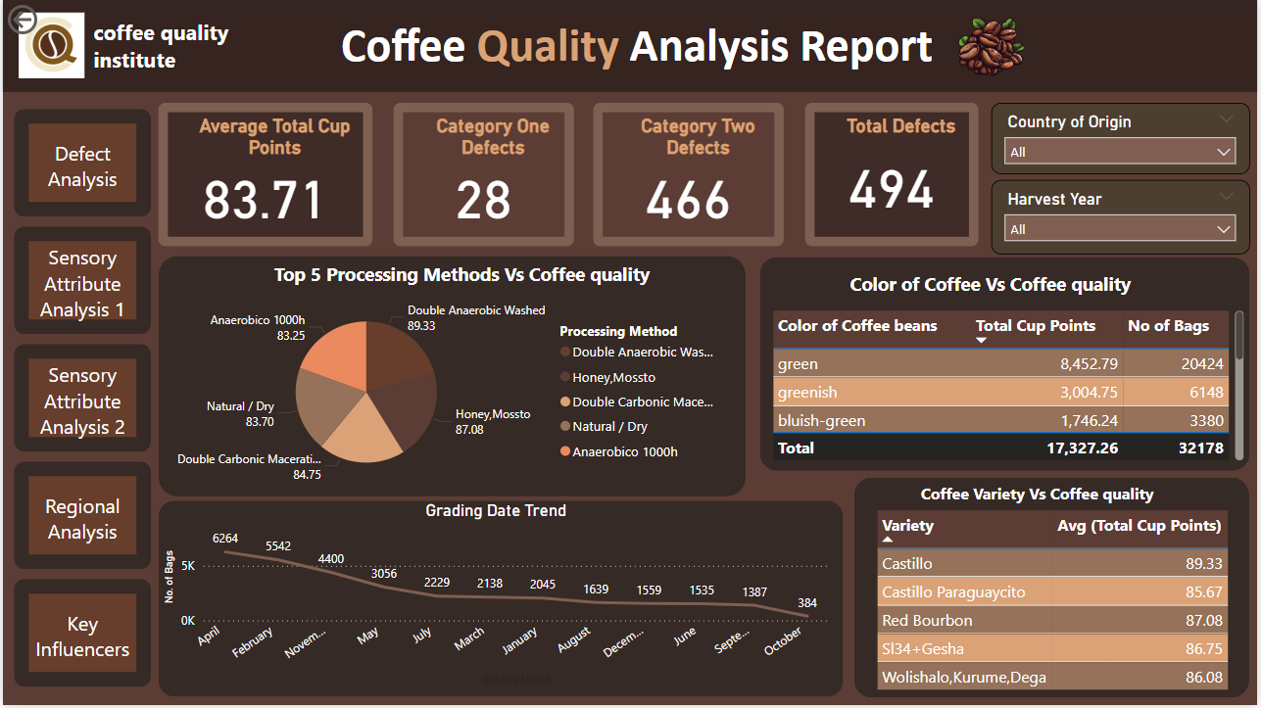

Slide 7
Insights
This report was created to analyze the quality of coffee based on various parameters, helping stakeholders to take decisions about coffee production, processing methods, and sourcing.
This report is vital for coffee producers, quality inspectors, and marketers to understand trends and improve coffee quality globally.
Double Anaerobic Washed has the highest score of 89.93.
Natural/Dry methods result in slightly lower quality with a score of 83.70."
The majority of high-quality coffee comes from green beans, contributing to 8,452.79 total cup points and 20,424 bags.
Castillo variety tops the quality chart with an average score of 89.33, followed by Red Bourbon.
"The number of bags shows a clear seasonal pattern, with peaks in April and November. This aligns with coffee harvest cycles and production trends."

Slide 8
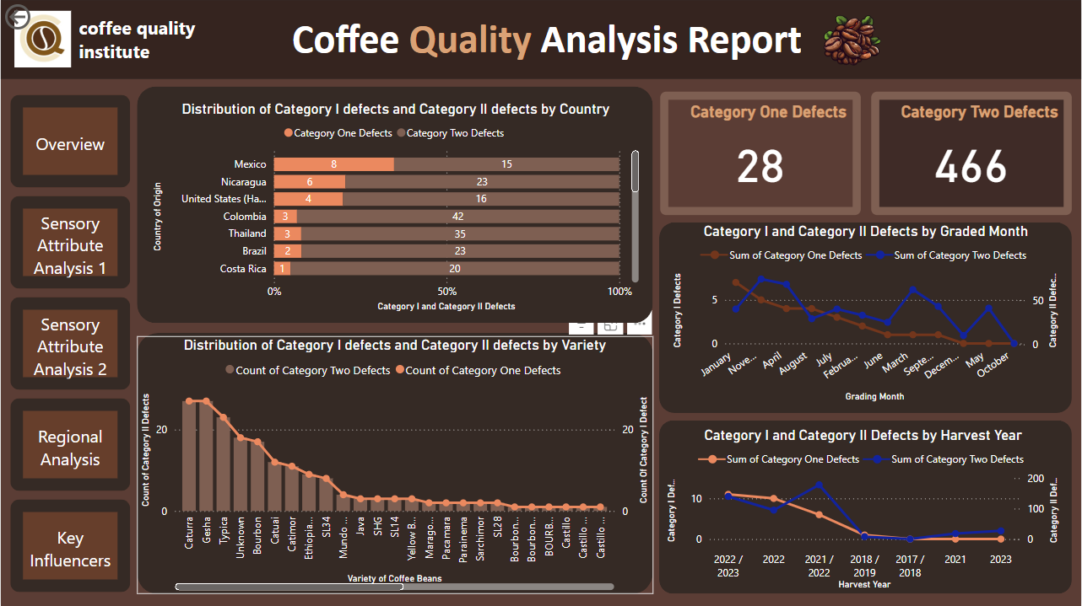

Slide 9
Insights
This is the defect analysis report to identify the trends and patterns in defect occurences and its impact on overall coffee quality.
Category 2 defects are more compared to category 1 defects.
Washed/Wet processed beans has more defects.
November, April & March Graded Beans has more defects.
Beans with Moisture Range more than 10% has more defects.
Harvest year 2021/2022 & 2022/2023 has more defected beans.
Note: Here, the Coffee Bean production in the respective years and Processed method is high, so it may also be the reason for more defects..

Slide 10
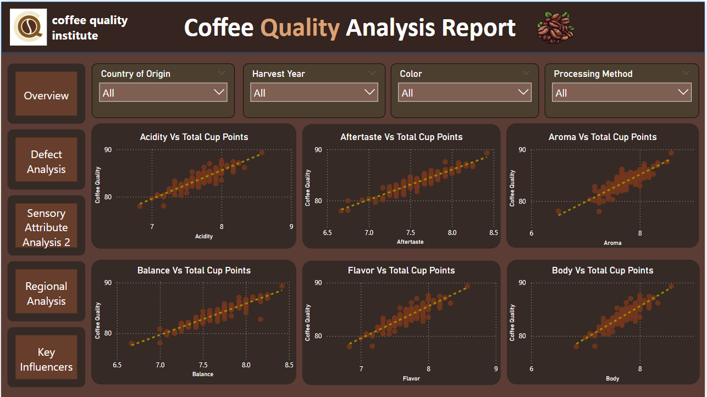

Slide 11
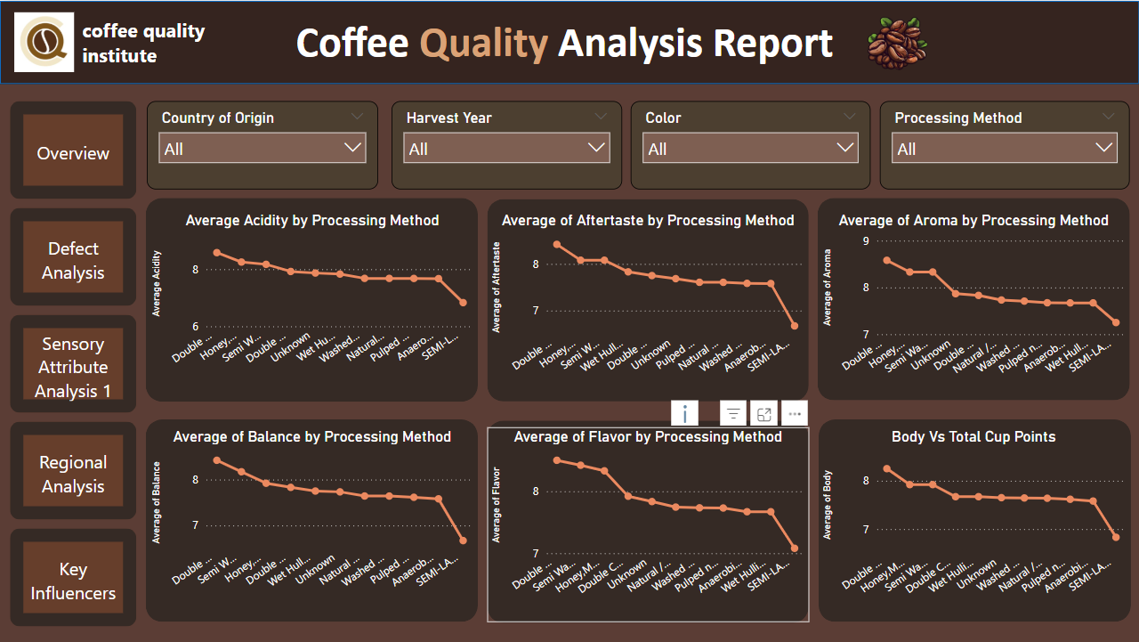

Slide 12
Insights
Scatter Plots shows how sensory attributes like Acidity, Aftertaste, Aroma, Balance, Flavor, and Body correlate with the Total Cup Points, a measure of overall coffee quality.
At 8.58, Double Anaerobic Washed had the highest Acidity_Avg and was 25.62% higher than SEMI-LAVADO, which had the lowest Acidity_Avg at 6.83.
﻿Across all 11 Processing Method, Acidity_Avg ranged from 6.83 to 8.58.
“Double Anaerobic Washed” and “Honey, Mossto” methods consistently achieve higher scores across all sensory attributes, indicating their effectiveness in enhancing coffee quality.

Slide 13
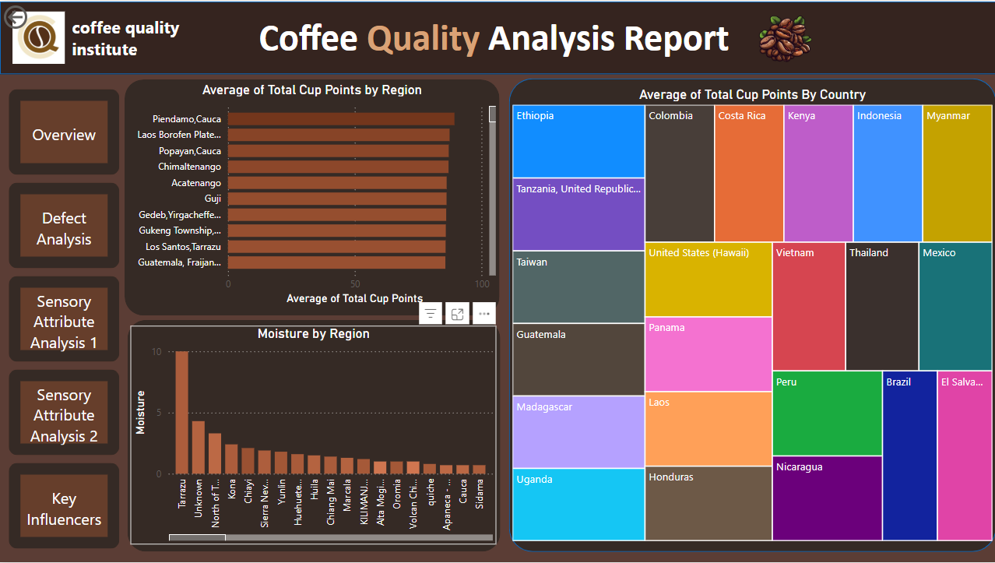

Slide 14
Insights
Piendamo,Cauca had the highest CupPoints_Avg at 89.33, followed by Laos Borofen Plateau and Popayan,Cauca. Minas Gerais had the lowest CupPoints_Avg at 78.﻿ ﻿Across all 109 Region, CupPoints_Avg ranged from 78 to 89.33.
Ethiopia, Tanzania, Taiwan, Gautemela, Madagasarcar are the top 5 Countries, showcasing their legacy of producing some of the finest coffees in the world.
Moisture content plays a critical role in the flavor and preservation of coffee. Tarrazu and Kona are among the regions with optimal moisture levels, ensuring the beans' longevity and flavor integrity."

Slide 15
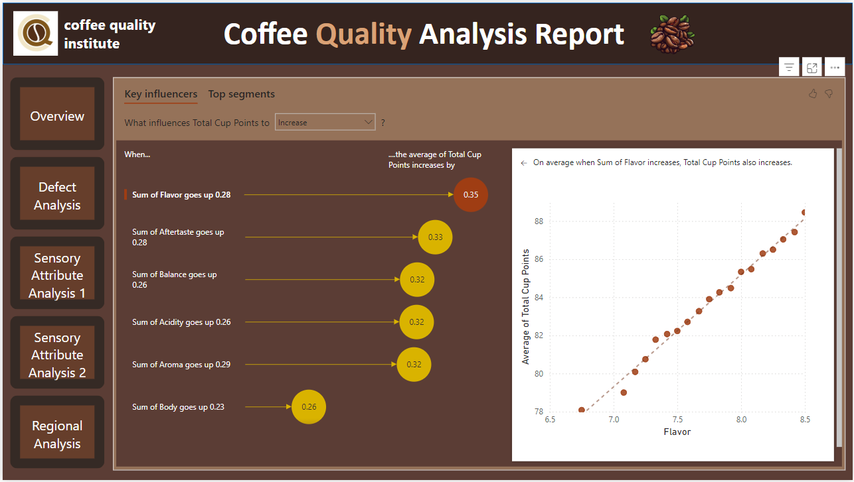

Slide 16
Insights
This report aims to uncover the key sensory attributes that influence the total cup points—a measure of coffee quality. By understanding these factors, producers and graders can focus on enhancing specific attributes to achieve higher quality.
Flavor as the Top Influencer:
"The most significant driver of coffee quality is flavor. As the Sum of Flavor increases by 0.28, the average total cup points increase by 0.35. This highlights how essential flavor is to determining quality."
"The scatterplot on the right visually illustrates this correlation, showing a clear positive trend between flavor and total cup points."
Impact of Aftertaste:
"Aftertaste is the second most influential factor. An increase of 0.28 in the sum of aftertaste results in a 0.33-point increase in total cup points. This shows that the lingering taste left by the coffee is critical to its perceived quality."
Other Significant Attributes:
"Attributes like balance, acidity, aroma, and body also play a vital role.

Slide 17
Insights
What are the key determinants of coffee quality as evaluated through sensory attributes such as aroma, flavor, acidity, etc.?
Aroma, flavor, Acidity, Body are the key attributes that impacts Coffee Quality much .
Castillo, Redbourn varieties are the top two Coffee Qualities.
Is there a correlation between processing methods, origin regions, and coffee quality scores?
The processing method impacts the coffee Bean attributes such as Acidity, Aroma, Body, Balance.
Regions in high Altitude produces Good Quality of Coffee Beans.

Slide 18
Insights
How do different variables interact to influence the Total Cup Points, which represent an overall measure of coffee quality?
The Overall Cup points of a Coffee is influenced by attributes Acidity, flavor, Aroma, Body,
Balance, After taste. The increase in this attributes enhances the Coffee Quality Points.
Beans Processed with Double Anaerobic washed, Semi washed & Honey/Mossto methods has high Cup Points.
Castillo, Red Bourbon & Sl34+Gesha are top 3 Quality Beans when compared to Cup Points.

Slide 19
THANK YOU

